Slide 1

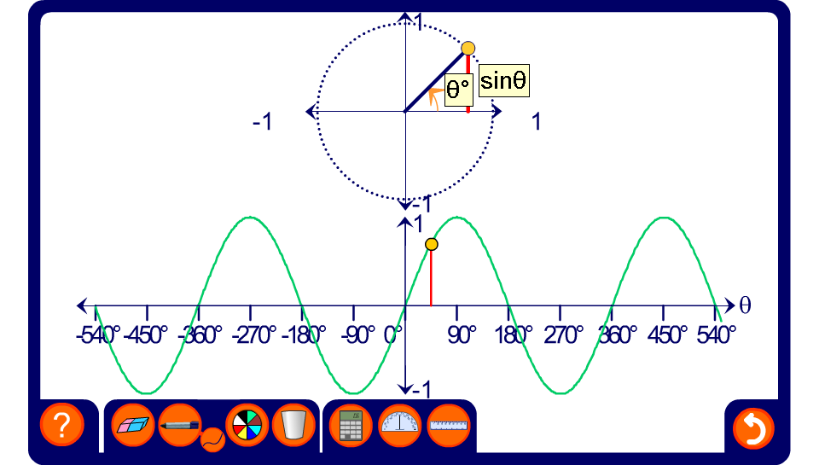


The graph of sin θ
Notes:
Trace out the shape of the sine curve and note its properties.
The curve repeats itself every 360°. Also, –1 < sin θ < 1.

